Slide 1

EMMA
Enhanced Multitasking Medical Assistant
Presented By Team iEMbotics
Tridib Ghosh
Sayantan Panda
Sankhadeep Dutta
Manasa Mahaadevan

Slide 2
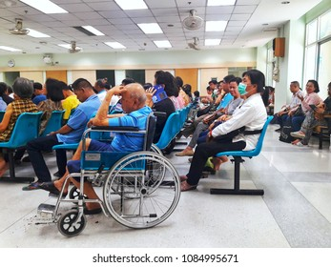

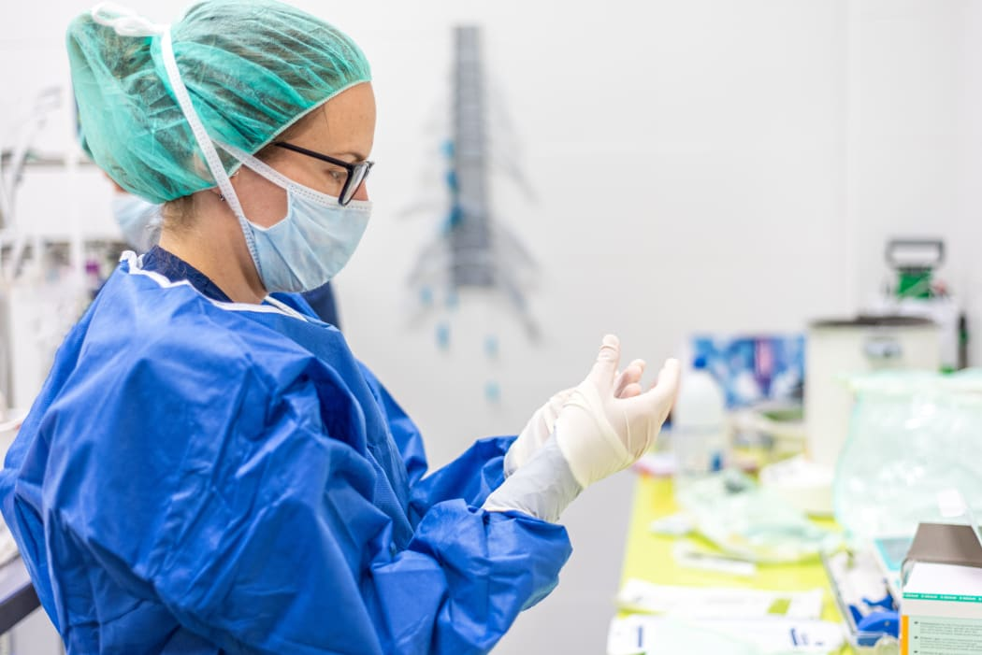

PROBLEMS

Slide 3

PROBLEMS
PROBLEMS

Slide 4


TRANSMISSION RISK
74%
36%
Nurses have skin-to-skin contact with patient
Other Staff Members
With patient
PROBLEMS
Source :

Slide 5

PATIENT CONNECTIVITY
43%
Of patients feel more positive & engaged interacting with socially assistive robots.
PROBLEMS

Slide 6
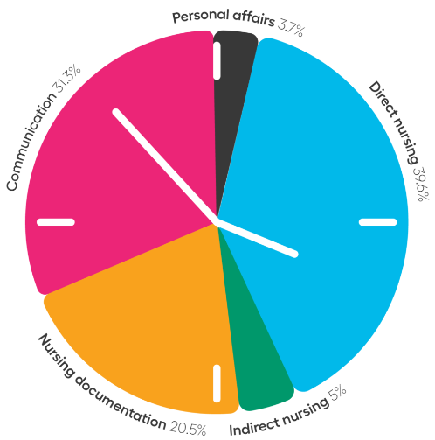


WORKLOAD STRAIN
62.0%
52.2%
Of nurses feel fatigue
Of doctors face anxiety
PROBLEMS
Source: 1 , 2

Slide 7
REGISTERATION & DOCUMENT MANAGEMANT
23%
94.5%
Of time spend on non-clinical tasks by nurses
nurses perform other tasks ,can be handled by robots
PROBLEMS
Source: 1, 2, 3

Slide 8
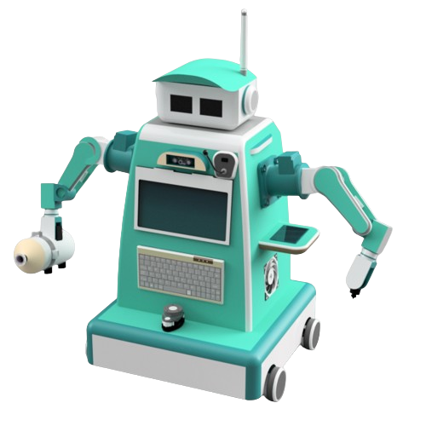
WE PRESENT EMMA!
A Multifunctional robot capable of….
Non contact service
Remote monitoring
Interactive companion
Automatic document generation
Automatic disinfection & sterilization

Slide 9
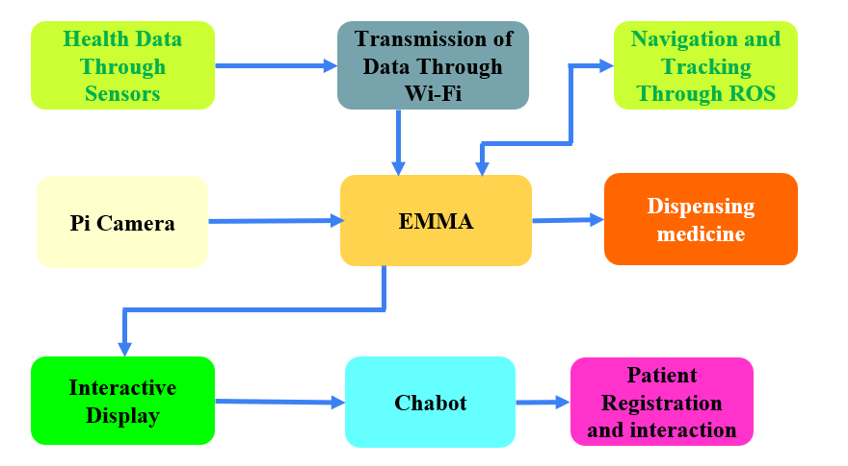
METHODOLOGY :-

Slide 10
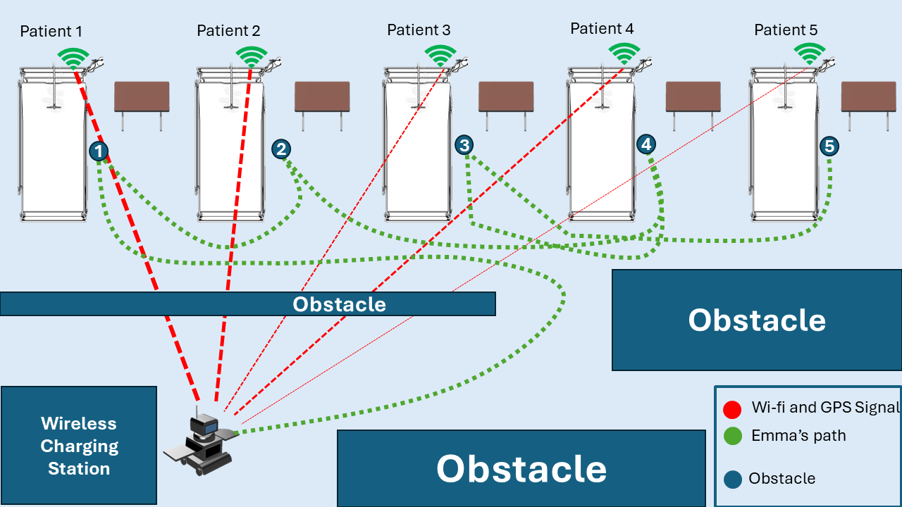
IMPLEMENTATION :-

Slide 11
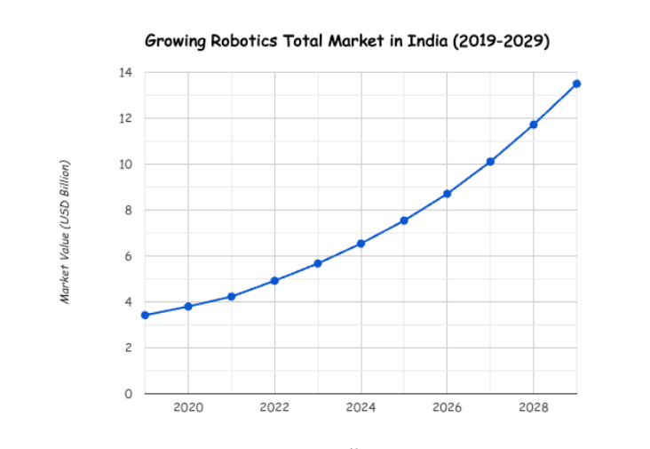
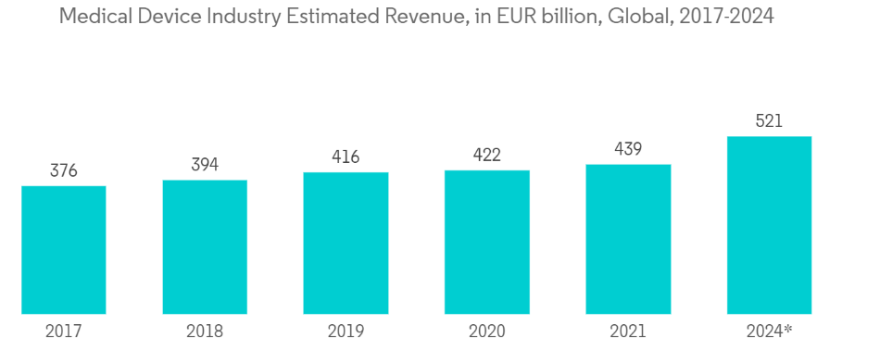
Market Trend: -
Market Size (2024):
$10.1 B
CAGR (2024-2035):
10.8 %
Source: 1

Slide 12
Market Opportunities: -
Elder Care : anticipated global increase in the elderly population ( 22% over 60 by next few years)
Neurological Disorders : rise in neurological disorders to 103 million by 2030 opens opportunities for rehabilitation robots
Pandemic Response: emergence of pandemic situations accelerated the adoption of robots.
Rising Mental Health Challenges: rising mental instability & stress among patients, affecting over 264 million globally (WHO)
Source:

Slide 13


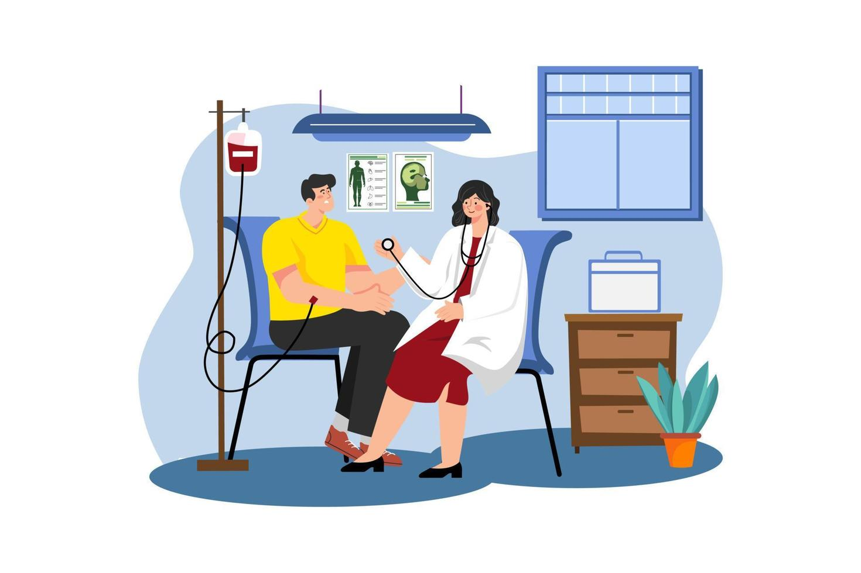
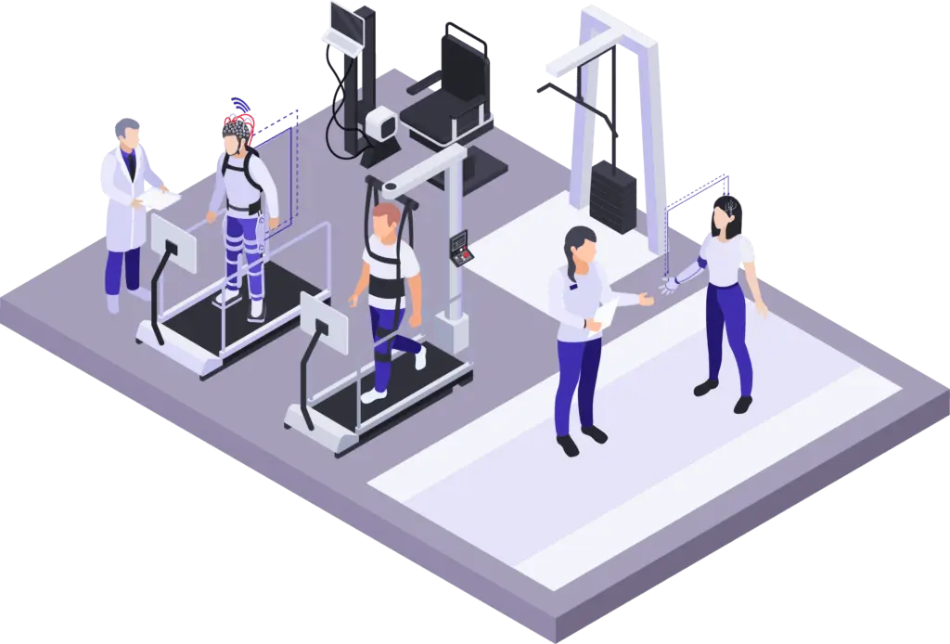
Target Customers
Primary: -
Hospital
Nursing Homes
Secondary: -
Clinics
Medical camps
Rehabilitation centre
Tertiary: -
Personal
Medical research centre

Slide 14
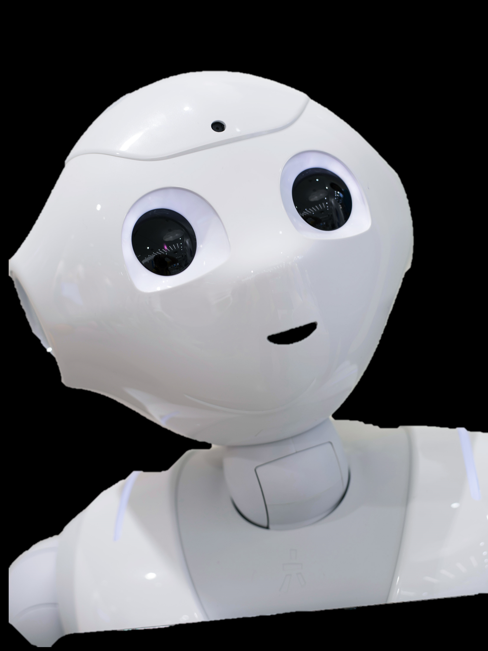
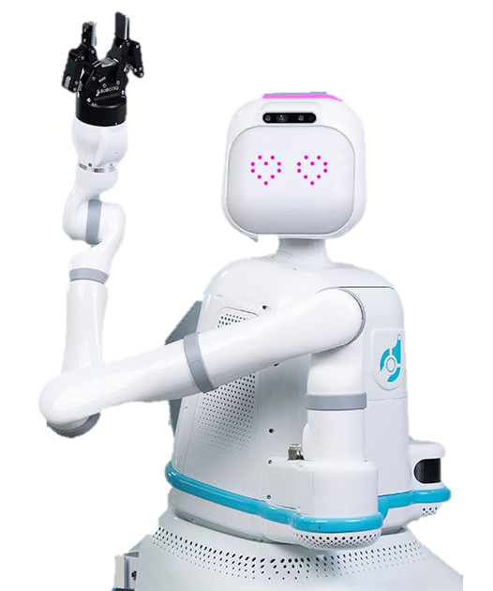
SCENARIO IN OTHER COUNTRIES
JAPAN: - Investment: - Japan’s healthcare robot investment since 2000($300 million).
Healthcare Service: - significantly enhanced Japan's elderly care services.
Evolution: - from assisting with routine tasks to monitoring vital signs & companionship.
USA: -
Reduced Nurse Burnout : alleviates nurse burnout, handles errands.
Improved Efficiency : data tracking of deliveries helps to optimize workflows
Enhanced Work Environment : improves staff morale and patient engagement. .
Source : 1 , 2 , 3

Slide 15






BUSINESS MODEL
Revenue
40%
15%
15%
15%
15%
Direct Sales
Software subscription
Leasing
Maintenace
Renting

Slide 16
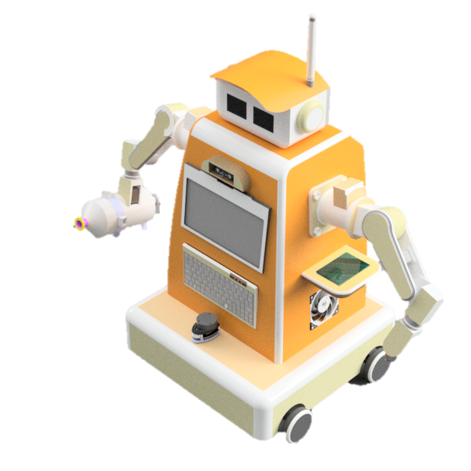
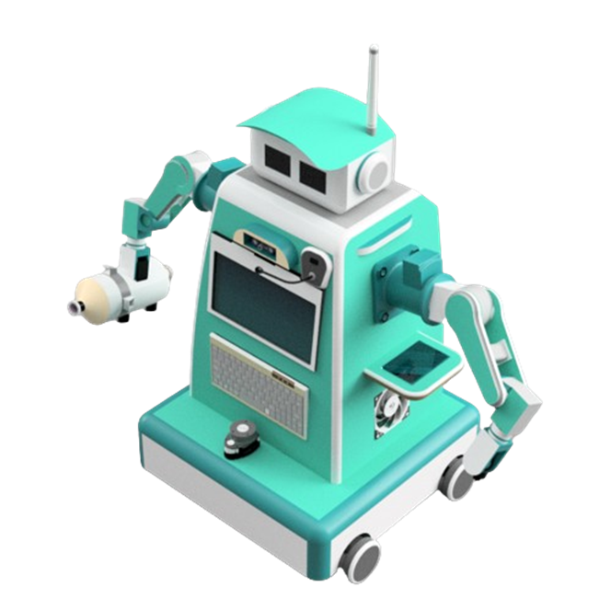
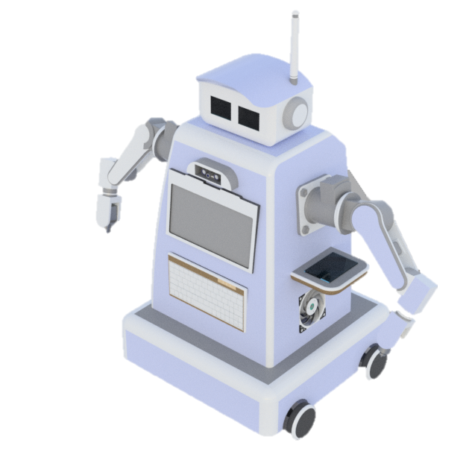
BASIC
ADVANCED
PRO

Slide 17
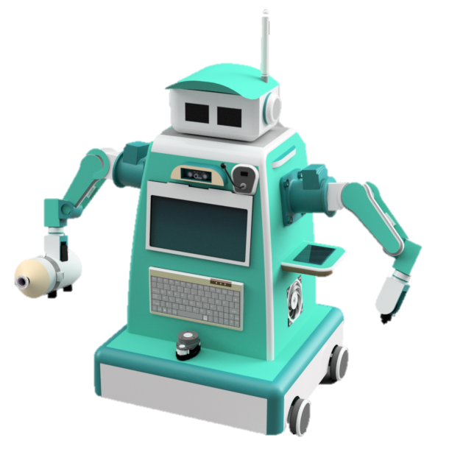
BASIC
ADVANCED
Basic : -
Interaction
Documentation
Vital Signs
Use:
Personal Use
Medical camps
Nursing Homes
PRO

Slide 18
BASIC
ADVANCED
PRO

Slide 19
Advanced: -
Interaction
Documentation
Vital Signs
Medication
Sanitation
Use: -
Nursing Homes
Camps
Personal
General Ward
ADVANCED
BASIC
PRO

Slide 20
BASIC
ADVANCED
PRO

Slide 21
Pro: -
Interaction
Documentation
Vital Signs
Medication
Sanitation
Virtual Checkup
Assistance
Use: -
Nursing Homes
Camps
Personal
General Ward
Pandemic Zones
PRO
BASIC
ADVANCED

Slide 22
BASIC
ADVANCED
PRO

Slide 23
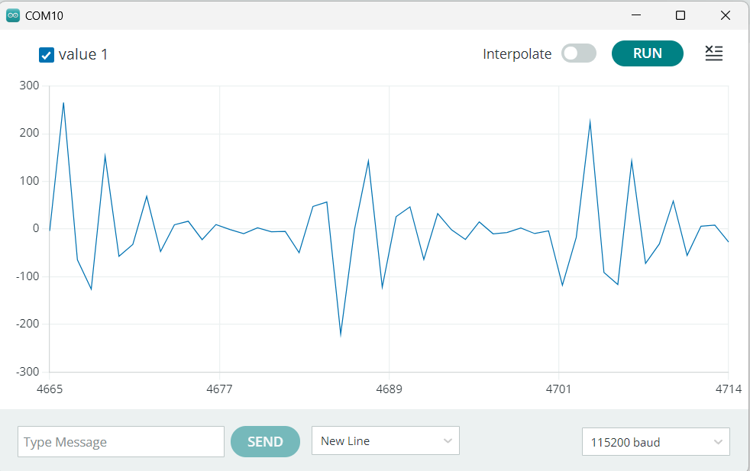
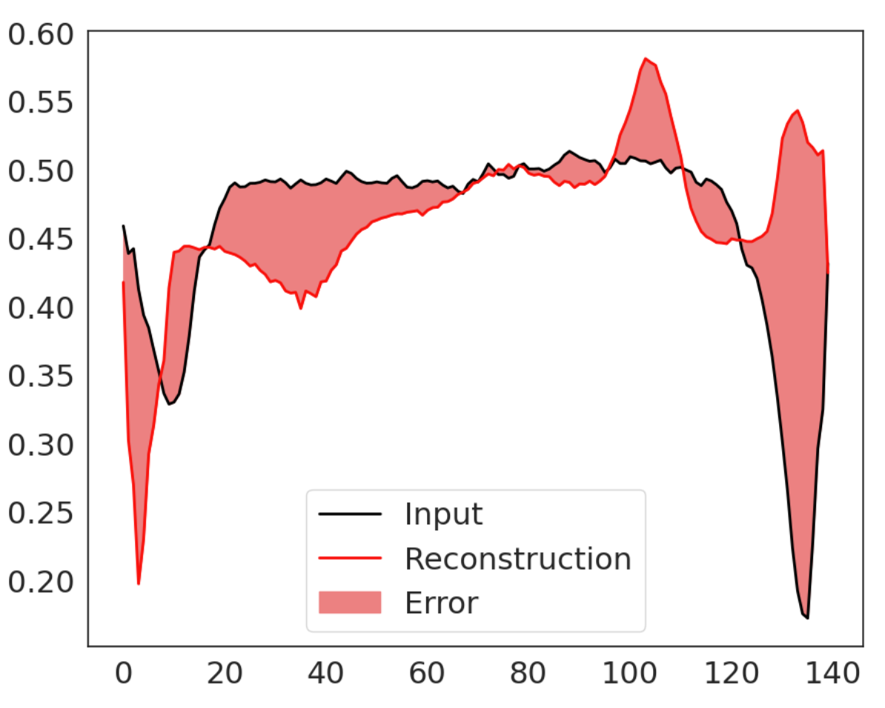
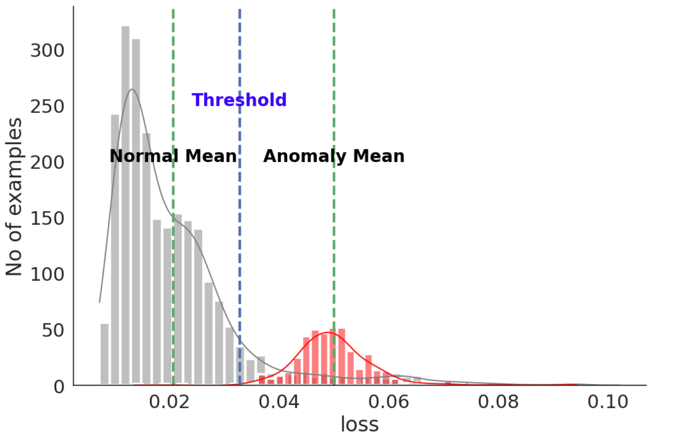
The Results
ECG_graph
mean values
Abnormal_data+ prediction
The anomaly detection model achieved an accuracy of 94.4%, a precision of 99.2%, and a recall of 90.7%.
The LSTM model for activity detection achieved a test loss of 0.308 and a test accuracy of 86.9%.

Slide 24




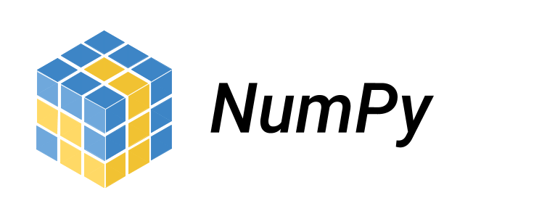





Tech Stack
Tkinter
Python
Pytorch
Embedded C
Raspberry pi
Arduino

Slide 25
THANK YOU

